Slide 1
Scaling and performance
COMP3421
Database Systems

Slide 2
Overview
Tablespaces
Database performance
Database indexes
B+ Tree Index
Bitmap Index
Denormalization
Distributed databases

Slide 3
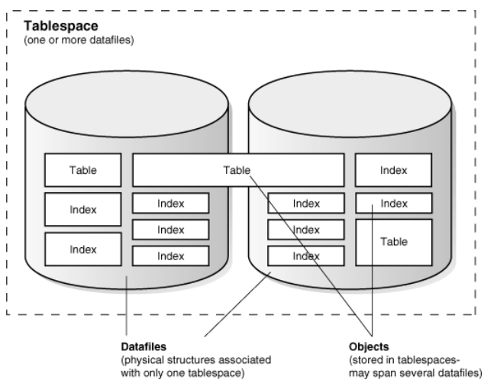
Increasing Capacity

Slide 4
Increasing Capacity
Database
Consists of one or more tablespaces
Tablespace
Logical structure stored on one or more datafiles
Datafile
Physical structure (file) that stores the database’s data
File structure depends on OS in which DBMS is running
Examples
A simple database may consist of a single tablespace that is stored on a single datafile
Another database may consist of multiple tablespaces each stored across multiple datafiles

Slide 5
Overview
Tablespaces
Database performance
Database indexes
B+ Tree Index
Bitmap Index
Denormalization
Distributed databases

Slide 6
Database Performance
Measures
Response time
Often measured in average query execution time
Throughput
Often measured in transactions per second
These measures deteriorate as:
The number of records stored in a database increases
The volume of data stored in a table increases
Particularly due to BLOB data
The number of transactions that the database services increases
The number of queries that join large tables increases

Slide 7
Database Performance
Why does performance deteriorate as the data volume increases?
New table records are stored in the first available tablespace segment
Records within the same table are probably stored in different segments throughout the disk(s)
Parent and child records with foreign key relationships are probably not stored in the same physical location
Records that match a specific search condition are probably not stored in the same physical location
As a result, these operations may require multiple disk accesses, which are slow

Slide 8
Database Performance
Why does performance deteriorate as the number of transactions increases?
Uncommitted queries may cause tables to be “locked”
Transactions can optionally “lock” an entire table or individual records in a table until committed or rolled back
These locks can optionally allow locked records to be read but not modified
A transaction may need to wait until another transaction has released a lock on one or more records or tables

Slide 9
Database Performance
Approaches for improving system performance
Database indexes
Denormalization
Distributed databases

Slide 10
Overview
Tablespaces
Database performance
Database indexes
B+ Tree Index
Bitmap Index
Denormalization
Distributed databases

Slide 11
Database Indexes
Database indexes
Data in datafiles is not stored in any particular order
DBMS places data in the next available segment in a tablespace
An index is a database object that stores information about data in a data structure that facilitates fast searching and sorting
When queries contain search conditions or joins using an indexed field, the index is used to facilitate the searching and sorting
Oracle index types
B/B+ Tree index (default index)
Bitmap index (Not available in MySQL)

Slide 12
B+ Tree Index
B+ Tree index (“balanced tree”)
Consists of leaf nodes and internal nodes each containing sorted database field values
Every path from the root of the tree to a leaf is of the same length (“balanced”)
Each leaf node value is associated with a pointer to the corresponding database record
The leaf node itself additionally points to the “next” leaf node
Each internal node value is associated with a pointer to a child node containing values less than the value and/or a pointer to a child node containing values equal to or greater than the value
All database field values (for the indexed field) are ultimately present in leaf nodes, forming a “dense” index
The internal nodes at a given level form a “sparse” index, in which entries appear for only some of the database field values

Slide 13
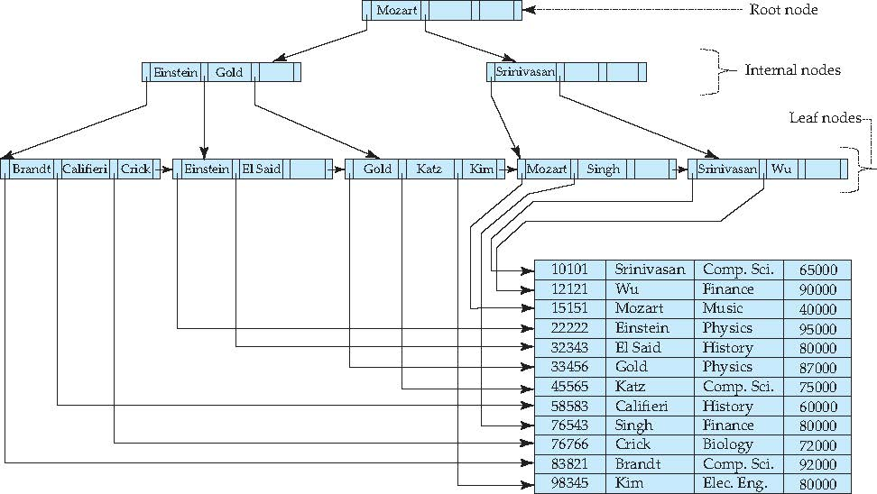
B+ Tree Index

Slide 14
B+ Tree Index
B+ Tree updates
Insertion
New values are added to leaf nodes
If a leaf node has exceeded its maximum size, it is split into two sibling nodes and a new entry is added to their parent node
If the parent node then has its maximum number of pointers, it too is split, and a new entry is added to its parent node
Deletion
If a value’s deletion causes a node to have too few pointers, it is merged with a sibling
If the maximum number of pointers is exceeded, the pointers need to be redistributed amongst its siblings
This redistribution may require changes in internal nodes
These steps propagate upwards when a deleted value is present in internal nodes

Slide 15
B+ Tree Index
B+ Tree before and after insertion of “Adams”

Slide 16
B+ Tree Index
B+ Tree before and after deletion of “Srinivasan”

Slide 17
B+ Tree Index
Duplicate values
If duplicate values are present in the indexed database field, their index search keys are made unique by creating a composite search key typically using the record’s primary key
Benefits
Maintains efficiency despite insert/update/delete operations
Very helpful for full ordered traversals
Most useful for unique or mostly-unique field values
Automatically created for primary keys and fields with a UNIQUE constraint

Slide 18
B Tree Index
B Tree indexes are similar to B+ Tree indexes
Differences
Internal node values point to database records in addition to pointing to child nodes
Internal node values do not appear again in leaf nodes
As a result, no linking between leaf nodes exists
Comparison
Records with index values in internal nodes are found more quickly in a B Tree than in a B+ Tree
B+ Trees allow a full ordered traversal more easily than B Trees due to the links between leaf nodes

Slide 19
Bitmap Index
Bitmap indexes are designed for efficiently querying tables using multiple field values
Records are assumed to be numbered sequentially
Done automatically by the database
A bitmap index is an array of bits that corresponds to a particular field value
One bitmap per field value
One bit per record
So, if a field has 2 distinct values amongst 5 records, then 2 bitmaps of 5 bits each will be used for the bitmap index
If the n^{th} record has value x, then the value of the n^{th} bit in the bitmap for x will be 1 (the value of the n^{th} bit in the bitmap for the other field value will be 0)

Slide 20
Bitmap Index

Slide 21
Bitmap Index
Queries involving multiple bitmaped indexes are answered using bitmap operations
Intersection (AND)
Union (OR)
Complementation (NOT)
Each operation takes two bitmaps of the same size and applies the operation to get the result bitmap
Males with income level L1 (from previous example)
10010 AND 10100 = 10000
Only the first bit is 1, so only the first record matches

Slide 22
Bitmap Index
Benefits
Useful in situations where records in a given table may be queried using multiple field values
Particularly useful when one or more of these fields have relatively little variation in values
Relatively little space overhead
Drawbacks
Updates are expensive

Slide 23
Database Indexes - Oracle
Syntax for creating an index
B Tree Example
Bitmap Example
CREATE [BITMAP] INDEX <index_name>
ON <table_name>(<attribute_name_list>)
CREATE INDEX inst_lname_idx
ON instructor(lname)
CREATE BITMAP INDEX inst_info_idx
ON instructor(gender, income_level)
Notes:
set autotrace on;

Slide 24
Database Indexes - MySQL
Syntax for creating an index after making table
B Tree Example after table creation
But often we want to create the index during table creation
CREATE INDEX <index_name>
ON <table_name>(<attribute_name_list>)
CREATE INDEX inst_lname_idx
ON instructor(lname)
CREATE TABLE foo (
id BIGINT PRIMARY KEY,
field1 INT,
INDEX (field1)
);
Notes:
set autotrace on;

Slide 25
Database Indexes
When should you create an index?
Query performance is objectionable
At least one of the tables in a common query contains a large number of records
>100,000 records
One of the search/join fields in a common query contains a wide range of values

Slide 26
Overview
Increasing capacity
Database performance
Database indexes
B+ Tree Index
Bitmap Index
Denormalization
Distributed databases

Slide 27
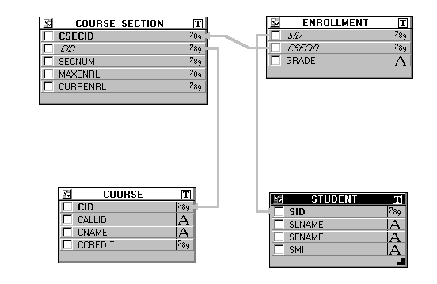
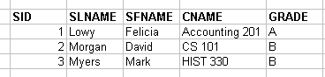
Denormalization
Create a summary table that duplicates the data associated with common join queries
Create triggers that automatically update the summary table when underlying table values change
This is similar to materialized views…
Denormalized Summary Table

Slide 28
Denormalization
Materialized view
Not available directly with MySQL
Oracle it is
Stores copies of the view fields in a separate table
Normal views are just stored queries
These copies can be refreshed on demand or on commit
Materialized views can be configured to allow updates directly to the views
These updates are then propagated to the original tables
Faster than using JOIN queries, but lots of system overhead and potential inconsistencies

Slide 29
Denormalization
Materialized view creation syntax
If FOR UPDATE is omitted, the data in the materialized view will be read-only
If REFRESH FAST ON COMMIT is present, the data in the materialized view will be updated when its underlying data is changed
Other statements can be used with the REFRESH command to control the frequency with which the data in the view is updated
CREATE MATERIALZED VIEW <view_name>
[FOR UPDATE] [REFRESH FAST ON COMMIT] AS
<SELECT query (with joins)>

Slide 30
Overview
Increasing capacity
Database performance
Database indexes
B+ Tree Index
Bitmap Index
Denormalization
Distributed databases

Slide 31
Distributed Databases
A distributed database consists of networked servers running independent DBMS instances that work together
This fragmentation must be transparent to users
Distribution types
Full replication
Every node runs the same DBMS and contains the same data
Homogeneous
Every node runs the same DBMS but may contain different data
Each node has the same schema design
Heterogeneous
Nodes can run different DBMSs and can contain different schemas
Nodes agree to share certain data values

Slide 32
Fully Replicated Distributed Databases
Consists of a publisher and subscribers
The publisher contains the master copy of the data
The subscribers receive updated copies from the publisher and deliver it to users
Subscriber
Subscriber
Publisher
Subscriber
Subscriber

Slide 33
Fully Replicated Distributed Databases
Replication approaches
Snapshot
The publisher distributes a snapshot of the entire database to each subscriber
Transactional replication
Changes are made to the publisher and either immediately or periodically distributed to subscribers
Merged replication
Changes are made separately to the publisher and subscribers and are merged periodically
Conflicting changes are controlled by a combination of transaction management and priority algorithms

Slide 34
Fully Replicated Distributed Databases
Advantage
If one site fails, others can take over
Queries may be processed by multiple nodes in parallel
Disadvantage
Time and resource intensive
More space, processing, management, inconsistencies, etc.
As a result, fully replicated distributed databases are best for databases whose contents don’t change often

Slide 35
Homogenous Distributed Databases
Nodes have the same DBMSs and schemas but different data
The data stored at each node should be that most likely to be used by its local users
Fragmentation
How data is divided among nodes
Approaches
Horizontal
Vertical

Slide 36
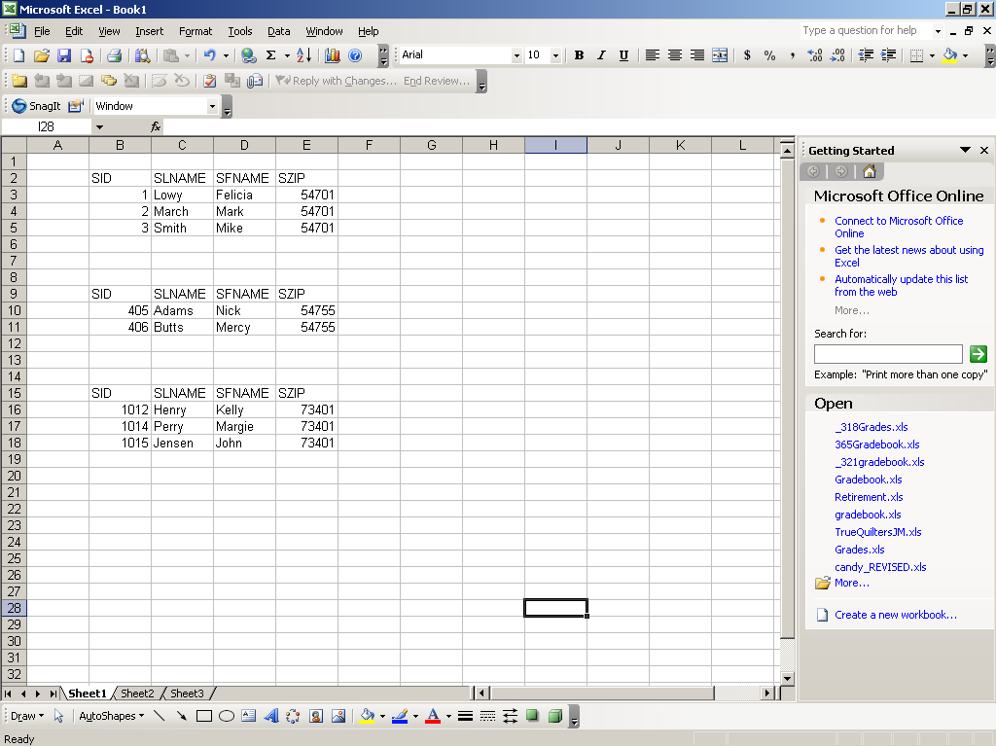
Homogenous Distributed Databases
Horizontal fragmentation
All table fields are included at each node
Appropriate records are distributed to each location
Typically determined via some field value
Node 1
Node 2

Slide 37
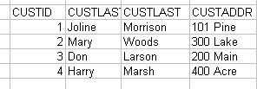
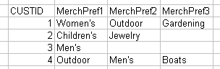
Homogenous Distributed Databases
Vertical fragmentation
All table records are included at each location
Appropriate fields are distributed to each location
Node 1
Billing
Node 2
Sales

Slide 38
Heterogeneous Distributed Databases
Nodes may have different DBMSs, schemas, and data
This makes query and transaction processing difficult
Users must be able to make requests in a database language used at their local sites
The heterogeneous system must appear as a single local database to users
Translations are required to allow communication between different nodes
DBMSs typically provide services to facilitate a heterogeneous connection to another node

